Slide 1


Slide 2
Geb
Geb brings together the power of WebDriver (Selenium), the elegance of jQuery content selection, the robustness of Page Object modelling and the expressiveness of the Groovy language.
Top resource is the Book of Geb

Slide 3
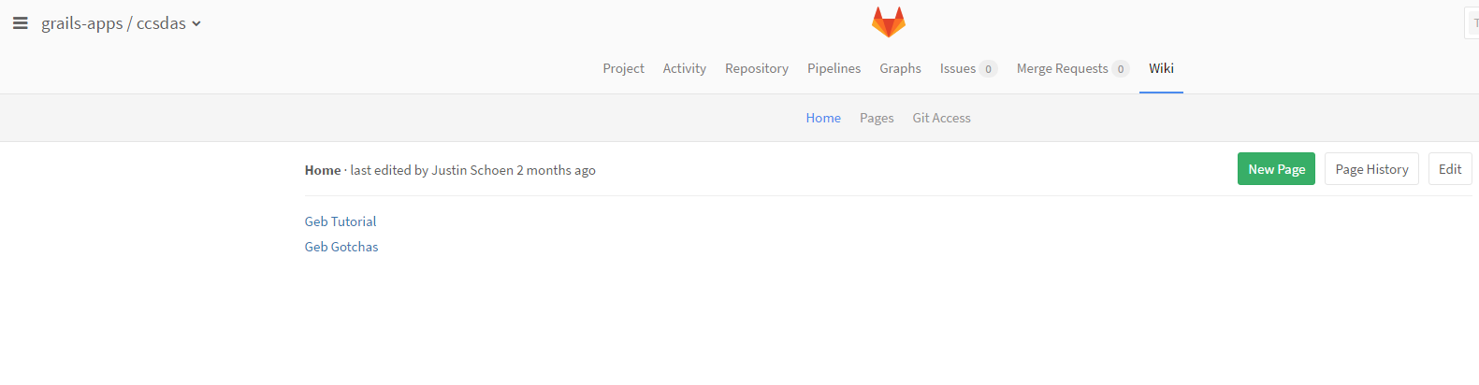
Configuration
For future reference, I have a tutorial on getting up and running with Geb on the wiki on gitlab by navigating to the ccsdas project, and then the wiki tab, and then Geb Tutorial
The following pages will take you through set up

Slide 4
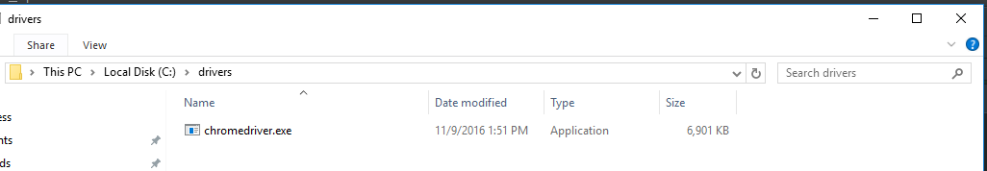
Configuration - Chrome Webdriver
Download the chrome webdriver
Extract it to an easily identifiable location

Slide 5
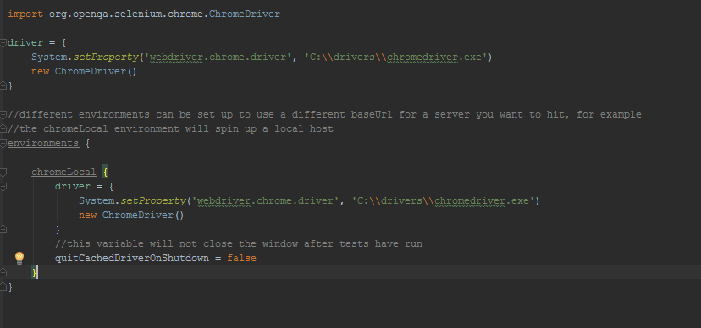
Configuration - GebConfig
First create a directory in your project structure called ‘functional’ similar to the unit test directory, then create a groovy class in this directory named ‘GebConfig’
You want your GebConfig to look like below. This is setting the default driver to be chrome, and sets up environments that you can specify when you run the tests
Setting the path to the chrome driver we extracted in the previous slide

Slide 6
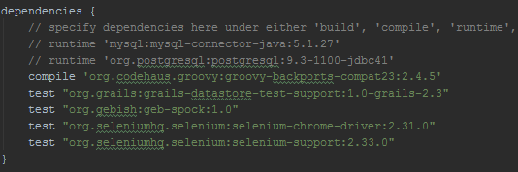
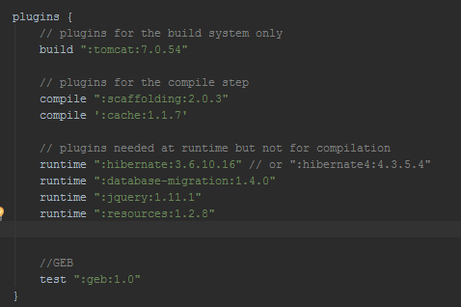
Configuration - BuildConfig
Navigate to your project’s BuildConfig.groovy class
You will need to add 3 dependencies: geb-spock, selenium chrome driver, and selenium support
You will also need to add 1 plugin: geb

Slide 7
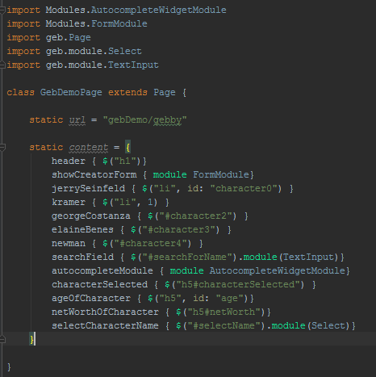
jQuery-ish navigator API
$(“div”, 0, class: “geb”)
$(“div”, id: “gebby”)
$(“div#geb”)
$(“div”, 0)
$(“div”, class: “geb”)
$(“div.geb”)
$(“div”).children(“a”).siblings(“h4”)

Slide 8
Page Object Pattern
Page Objects are essentially representations of pages, they hold the contents of the page, the url, and can house common methods such as navigation around the page that may need to be reused in multiple tests.
To use the features of Page objects, simply extend Page in your class.

Slide 9
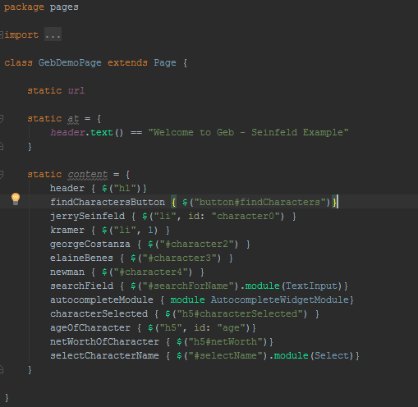
The url for the GebDemoPage. You can set the url in the PageObject, but sometimes I prefer to set it in the setupSpec() method in the case you need to pass parameters.
Extend Page
The ‘at’ block is used as an assertion. What it’s saying here is that the header will have text that says “Welcome to Geb – Seinfeld Example” AT the GebDemoSpec page. If the header element does not say that, the test will fail immediately.
The ‘content’ block houses the elements on a page that will be used to interact with. You’ll notice that a few of the elements are modules. These modules have an API that we can use to interact with the element much easier.

Slide 10
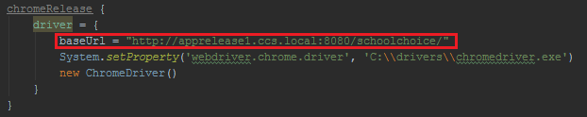
The Base URL
If you run your tests locally, geb wants to spin up the app each time, unless you already have it running or port 8080 is being used. It will even try to spin up the app if you specify a different environment, like a release server.
If you want to run against your local host, the base url will be localhost:8080/whateverAppYouAreIn and you don’t have to do any additional configuration in the GebConfig class. If you want test against a release server, for example, you have to set the base url in the GebConfig like in the top picture.
Example of how to access the baseUrl is on the next page
Example use in the GebConfig class

Slide 11

setupSpec()
When writing a spec class, where you write the functional tests, you’ll extend GebSpec. One of the features that comes with GebSpec is the setupSpec() method. The setupSpec() method will run one time at the beginning of your spec file. It’s extremely useful for setting up any data, especially urls when the url needs to be parameterized. GebSpec also includes cleanupSpec(), which runs last.
Static url variable of the GebDemo page object
Controller and view
Page Object
Base url

Slide 12
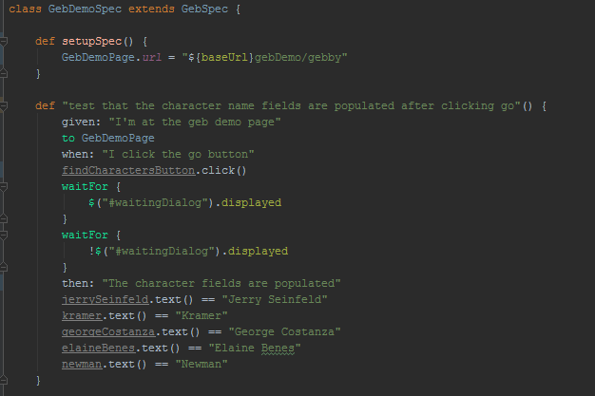
Putting it all together
‘findCharactersButton’ is content on the GebDemoPage
‘to’ keyword tells geb to navigate to the GebDemoPage, using the url set for that page
I’ll explain the waitFor closures on the next page
These are all assertions. Each of these fields are content on the GebDemoPage

Slide 13
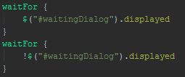

waitFor closure
The waitFor closure is going to be used most frequently with ajax requests when you’re waiting for data to get populated somewhere on the page or for a loading dialog to appear and disappear.
In the example below on the left, there are two waitFor closures. We have to wait for the dialog to show up, then wait for it to disappear. We have to wait for it to show up because the webdriver moves so quickly that if you tell it to wait for it disappear it will think it’s already gone, thus moving forward before the request has completed or data has been populated.
If you don’t have a dialog, you would be able to just wait for data to be populated or whatever it is that changes that you’re waiting to see. (see right picture)

Slide 14
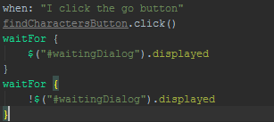
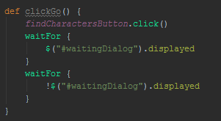

Page Object Methods
In many cases we’ll have repeated actions written out in our specs, such as clicking a button, filling out fields, etc. When you find yourself writing the same steps multiple times, move them into a method in the Page Object and call the method from the spec. This will clean up tests dramatically and improve maintainability.
Now, back in the GebDemoSpec, replace the old block of code with the method created in the page object.
I’ll use this same step multiple times throughout the spec file so it should be its own method.
Add this method to the GebDemoPage.

Slide 15
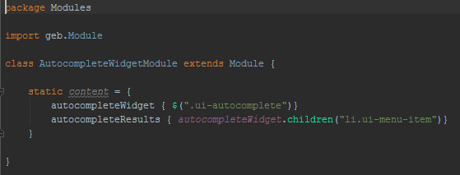
Modules
Modules are re-usable definitions of content that can be used across multiple pages.
I created a module for a UI autocomplete widget. It doesn’t belong in a Page Object because then it would have to be repeated in each page it’s used. By creating a module out of it, you can access it from anywhere
Extending ‘Module’ is necessary as it allows you to define the content of the module and treat it similar to a Page Object
See use on next slide

Slide 16
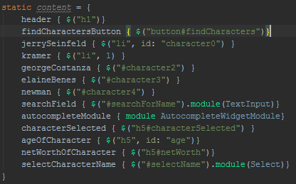
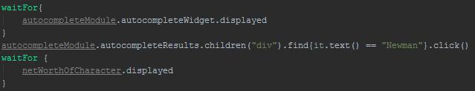
In the GebDemoPage, we create a piece of content to represent/use the AutocompleteWidgetModule
In the test, we can use the autocompleteModule defined in our page object to access content defined in the
AutocompleteWidgetModule. Here we wait for the widget to show up, then we search through the results to find the result with the text we want, then we click it.

Slide 17
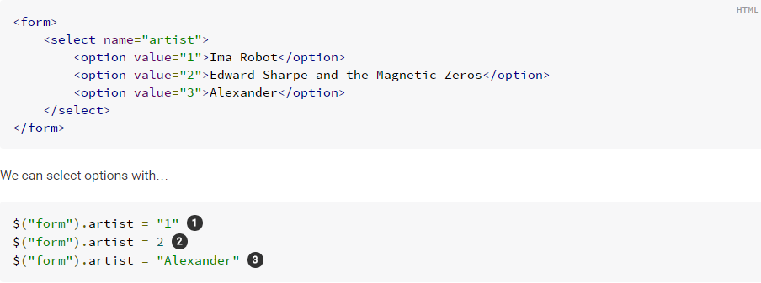
Form-Control Shortcuts
If your contents are enclosed in a form, shortcuts are included to easily interact with them by selecting the name attribute of the elements in the form
The example below shows how to interact with selects. Similar shortcuts exist for text input, checkboxes, radio buttons, multi selects, etc…
http://www.gebish.org/manual/current/#setting-form-control-values

Slide 18
Run Geb Tests
To run all functional tests
grails dev test-app functional:
To run a certain functional test
grails dev test-app functional: GebDemoSpec
To run against a grails environment to hit a different database, for example
grails dev test-app –Dgrails.env=support functional: GebDemoSpec
To run against a grails environment and a geb environment, useful when several environments are defined in the GebConfig to run tests against different webdriver or url
grails dev test-app –Dgrails.env=support –Dgeb.env=chromeLocal functional: GebDemoSpec

Slide 19
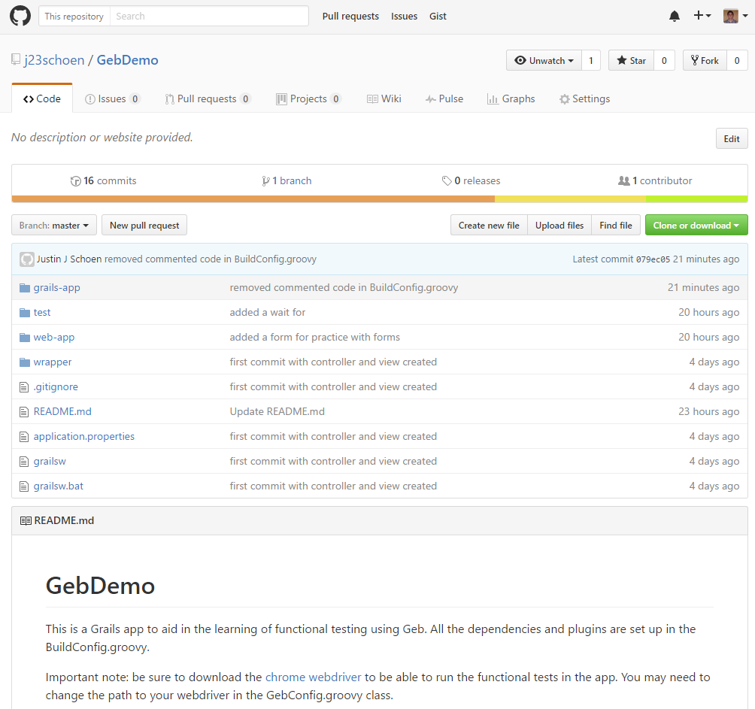
Action Steps
I highly recommend cloning my GebDemo project on git; I have it linked on the next slide. It is a grails project with Geb configured, one controller, a few gsps, and a spec file with a few basic tests

Slide 20
Resources
GebDemo on git
Book of Geb

